Slide 1
AI Prediction of Student Success in Online Programs
Jacob Javier
Springboard Data Science Career Track

Slide 2



Communication is one of the biggest challenges to online learning
How can educators effectively gauge their students’ engagement with the material in online programs?
Notes:
Use this slide to communicate the barriers that come with virtual communication
How should educators communicate educational content?
How should students communicate their needs?
How accessible should educators be?

Slide 3
What features dictate student success in online programs, and can those features predict the trajectory of future cohorts as an advising tool?
The model must identify key features that determine final result classification.
The model must have a success rate greater than 50%.
Notes:
In context with the online academic program specifics, a tool like this can be used to identify at-risk students while suggesting improvement areas that those students could use to reengage with the course

Slide 4
Collection
December 2015 online program for The Open University, UK
Cleaning
Preprocessing
Encoding
26 features from 32,953 students that took 206 assessments
Aggregation
Average score
Maximum and average assessment length
Total and average proactive assessment interactions
Total and average clicks to complete each assessment
Administrative features
5% of the continuous features
Duplicates
Ordinal (0 – i)
Nominal (Count frequency)
Binary
StandardScaler
Dropped

Slide 5
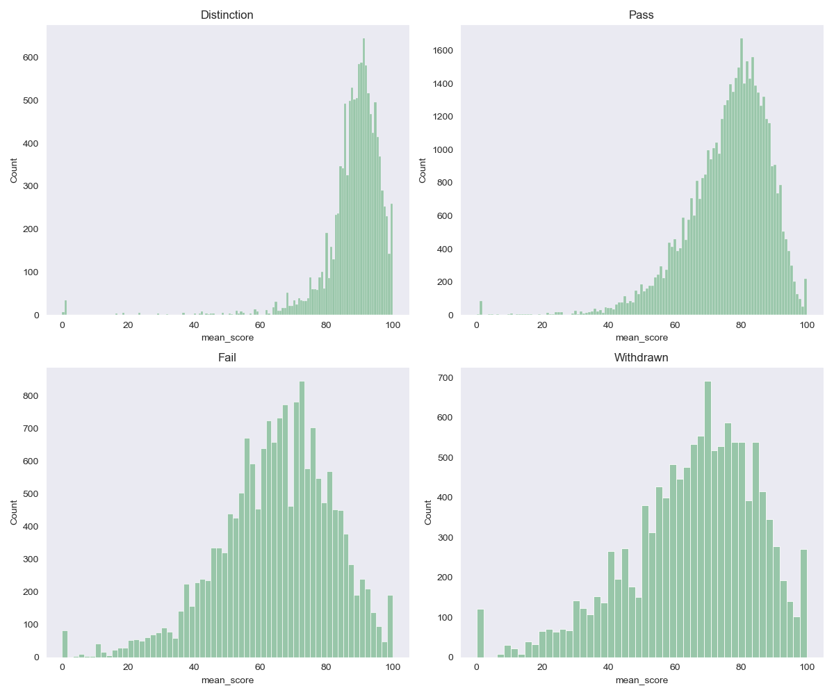
How does the average score for each assessment differ between the final results?
F-Stat | P-value
8332.65 | 0.0
Final Result | Average Score (%)
Distinction | 89.28
Pass | 77.03
Fail | 65.15
Withdrawn | 63.74
Notes:
Highlight the final result values: Distinction, Pass, Fail, Withdrawn

Slide 6
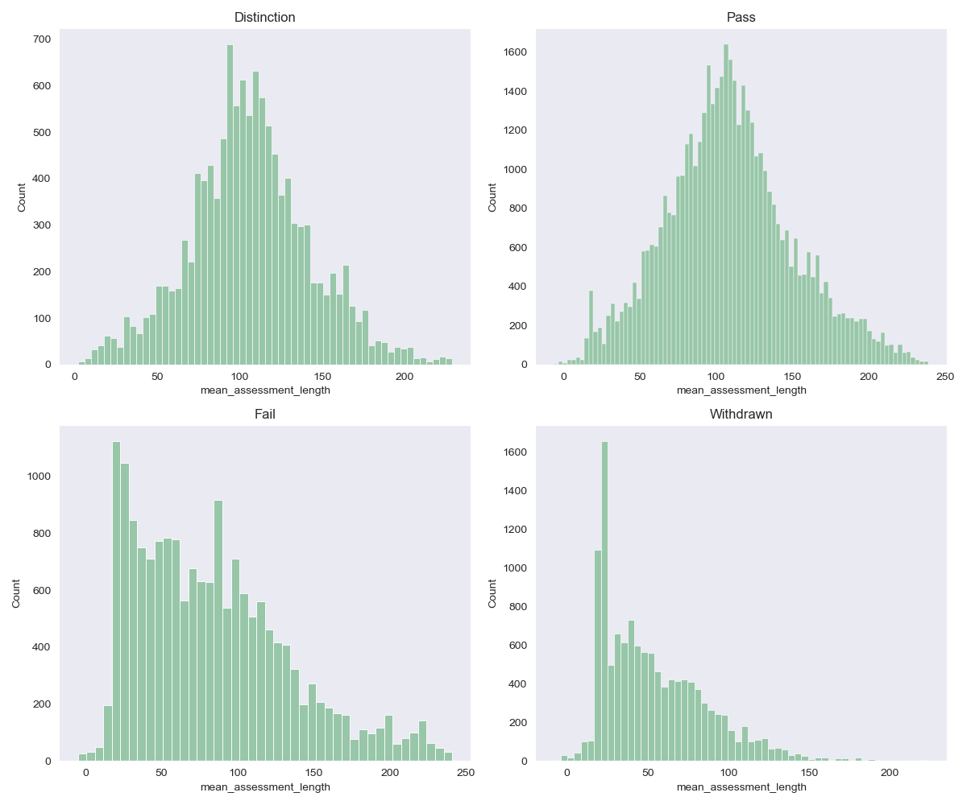
How does the material interaction for each assessment differ between the final results?
Stat | F-Stat | P-value
Average active | 2.26 | 0.08
Average duration | 6453.60 | 0.0
Final Result | Average duration (days)
Distinction | 105.99
Pass | 108.87
Fail | 83.11
Withdrawn | 53.93
Notes:
Highlight the final result values: Distinction, Pass, Fail, Withdrawn

Slide 7
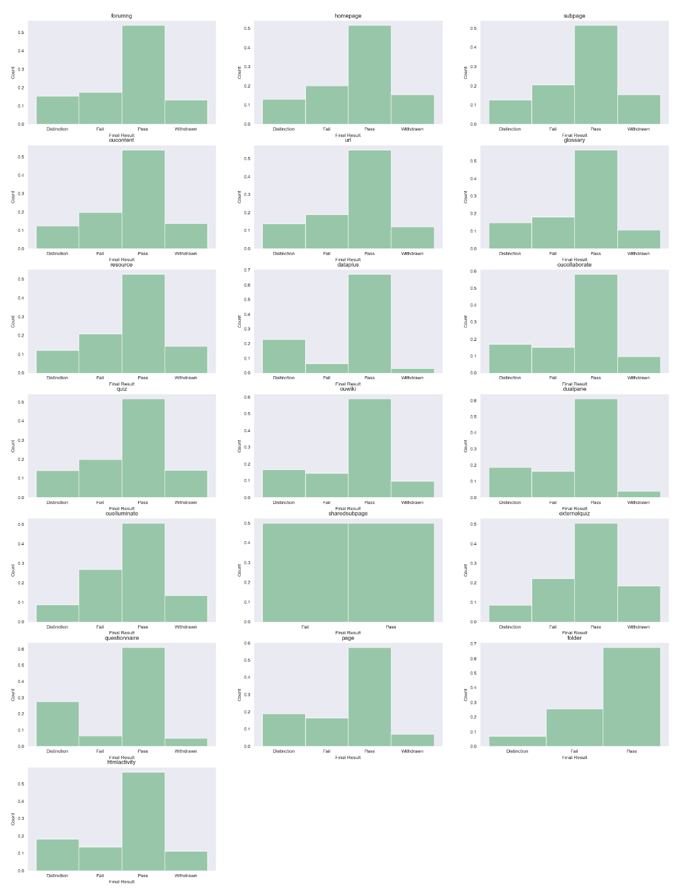
Is there a difference between activity types that determine the final results?
χ² | P-value
87.53 | 0.0
Notes:
Highlight the final result values: Distinction, Pass, Fail, Withdrawn

Slide 8
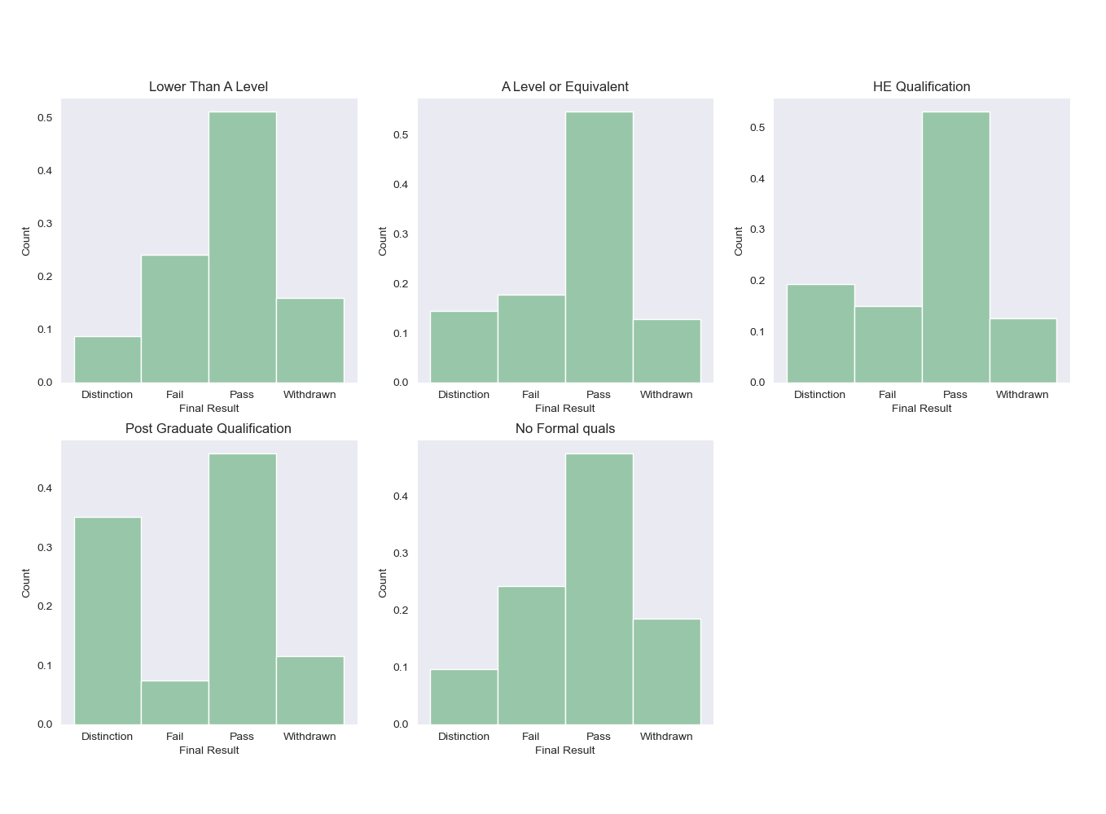
Is there a difference between activity types that determine the final results?
χ² | P-value
26.22 | 0.0
Notes:
Highlight the final result values: Distinction, Pass, Fail, Withdrawn

Slide 9
Supervised Multivariate Classification Modeling
Splitting
25% test set
Stratified: class imbalance
Shuffled: ordered data
Hypertuning
RandomizedSearchCV
Stratified 5 fold
250 iterations
Scoring: F1-score
Models
Decision Tree (dt)
Random Forest (rf)*
K-Nearest Neighbors (knn)*
Logistic Regression (lr)

Slide 10
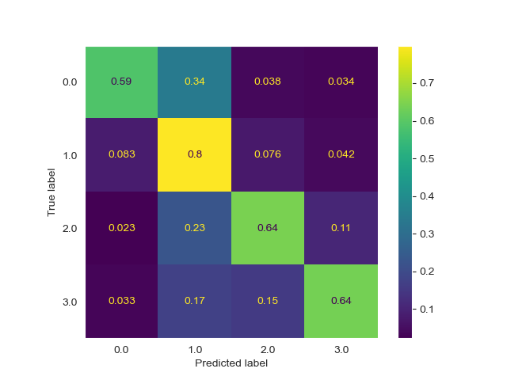
Classification
knn model
K-Nearest Neighbors
Hyperparameters
Weights: Distance
Algorithm: Ball tree
Neighbors = 2
Metrics
Accuracy = 0.72
Weighted F1-score = 0.72
Model best classified passing students
79% of the students were identified correctly
Passing students account for 53% of the students

Slide 11
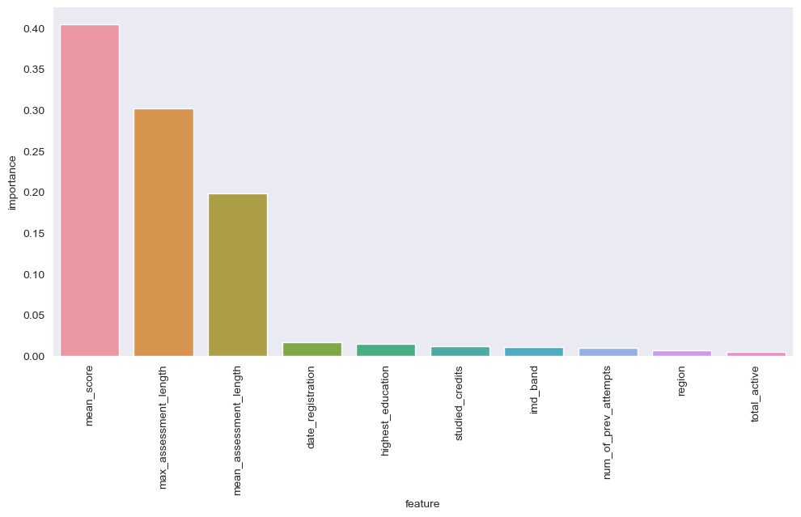
Feature Importance
rf model
Random Forest
Hyperparameters
Max features: squareroot
Criterion: gini index
Estimators = 300
Max depth = 60
Min samples = 0.01
Metrics
Accuracy = 0.64
Weighted F1-score = 0.59
Features
Average score (importance = 0.40)
Max Assessment Length (Importance = 0.30)
Mean Assessment Length (Importance = 0.20)

Slide 12
Conclusion
The model must identify key features that determine final result classification.
Random forest identified average score and how long the assessments were active
The model must have a success rate greater than 50%.
The highest accuracy was 72% with the K-Nearest Neighbors classifier.
Using resampling techniques to reduce the class imbalance may improve the results.

Slide 13
Future Work
Data
Additional Studies
Rebalance classes
Feature importances by
Average score
Highest education
VLE activity type
What factors lead to students turning in their assessments later than others?
How has online learning changed between 2015 to present?

